Slide 1
“ONLINE MEDICAL STORE MANAGEMENT”
Welcome To

Slide 2
Presented By
Labade P.A Shelar N.D
Kakade D.D Nimbhore S.S

Slide 3
Guided By:
Prof.Lagad S.R
HOD:
Principal:
Prof.Sayyed J.I
Prof.Bhoite P.D

Slide 4
Contents
Abstract
Introduction
Purpose
Existing System
Proposed System
System Requirement
System Structure
Screenshots
Conclusion
Future Scope
References

Slide 5
ABSTRACT
The purpose of Online Medical Store Management System is to automate the existing manual system by the help of computerized equipment and full-fledged computer software, fulfilling their requirements, so that their valuable data/information can be stored for a longer period with easy accessing and manipulation of the same. The required software and hardware are easily available and easy to work with.
Online Medical Store Management System, as described above, can lead to error free, secure, reliable and fast management system. It can assist the user to concentrate on their other activities rather to concentrate on the record keeping. Thus it will help organization in better utilization of resources. The organization can maintain computerized records without redundant entries. That means that one need not be distracted by information that is not relevant, while being able to reach the information

Slide 6
INTRODUCTION
The "Online Medical Store Management " has been developed to override the problems prevailing in the practicing manual system. This software is supported to eliminate and in some cases reduce the hardships faced by this existing system. Moreover this system is designed for the particular need of the company to carry out operations in a smooth and effective manner.
The application is reduced as much as possible to avoid errors while entering the data. It also provides error message while entering invalid data. No formal knowledge is needed for the user to use this system. Thus by this all it proves it is user-friendly. Medical Store Management System , as described above, can lead to error free, secure, reliable and fast management system. It can assist the user to concentrate on their other activities rather to concentrate on the record keeping. Thus it will help organization in better utilization of resources.

Slide 7
PURPOSE
The objective of Medical Shop Management System providing the medicines to the customers according to their request which contains the type of the medicine and the quality. The manufactures and manufacture the medicine requested and the same will be sent to the dealers. All the records will be saved systematically and not manually through paper work to solve further confusions and to make life easy. Database is cleared yearly or depending on certain span of time. It is an error free system and user friendly. It reduces paper work

Slide 8
EXISTING SYSTEM
The Existing system of the medical shop records just goes through maintaining the files according to the medicine companies. Like the records of the particular company. product etc. then the records of that each company schemes. The sections are created on the basis of a company are maintained on separate page, that of shops on the section of shops.
Problem Analysis
To develop the computerized management system of medical shop from the manual system implemented at present.
To maintain the record of the shop.
To maintain the information of items being purchased.
To maintain the records of customers billing and stock
Limitations of existing system
It requires a lot of human time and thus is time consuming.
The job of maintaining the records manually is very tedious.
Voluminous data cannot be handled accurately.
We cannot find a record of particular product, company or bill.
Outstanding bills cannot be provided at proper time manually because it requires a lot of time.

Slide 9
PROPOSED SYSTEM
The proposed system can overcome all the limitations of the existing system. The system provides proper security and reduces the manual work. The proposed system tries to eliminate or reduce these difficulties up to some extent. The Minimize manual data entry
Better services
User friendliness and interactive
Minimum time required proposed system will help the user to reduce the work load and mental conflict. The proposed system helps the user to work user to work user friendly and he can easily do his jobs without time lagging. It has got following features.
Ensure data accuracy
Secure data accuracy
Proper control of the higher officials
Minimum time needed for the various processing

Slide 10
SYSTEM REQUIREMENT
Hardware Requirements
Processor: Intel dual core or above
Processor Speed: 1.2GHZ or above
RAM: 4GB RAM or above
Hard Disk: 500GB hard disk or above
Software Requirements
Language: PHP(v.8.1.0)
HTML
Bootstrap
Database: SQL Server
Operating System: Windows 10/11

Slide 11
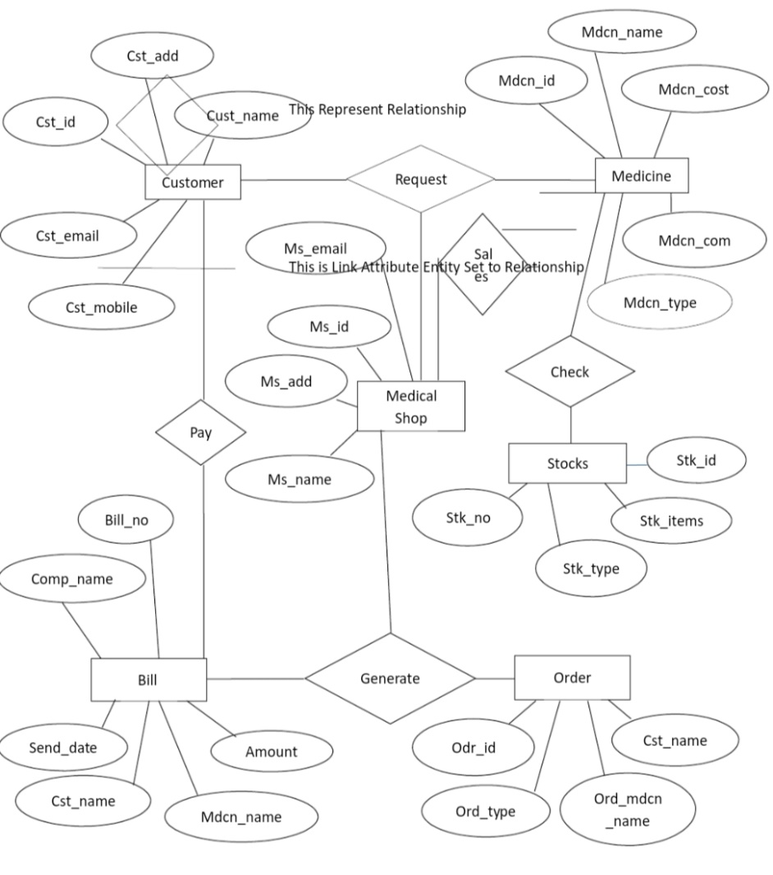
SYSTEM STRUCTURE
Fig. ER Diagram

Slide 12
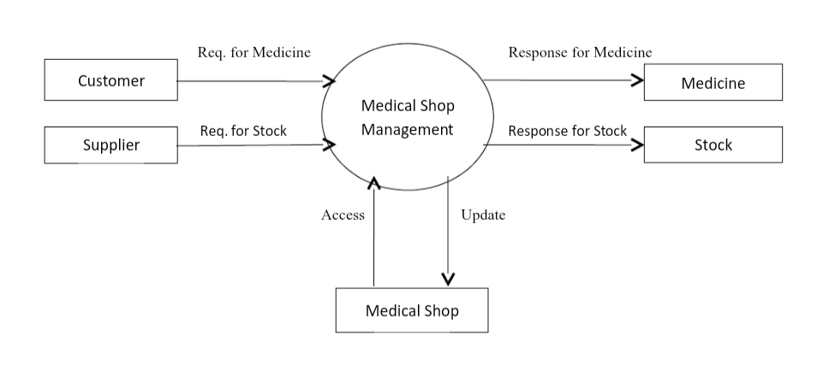
SYSTEM STRUCTURE
Fig. DFD Diagram

Slide 13
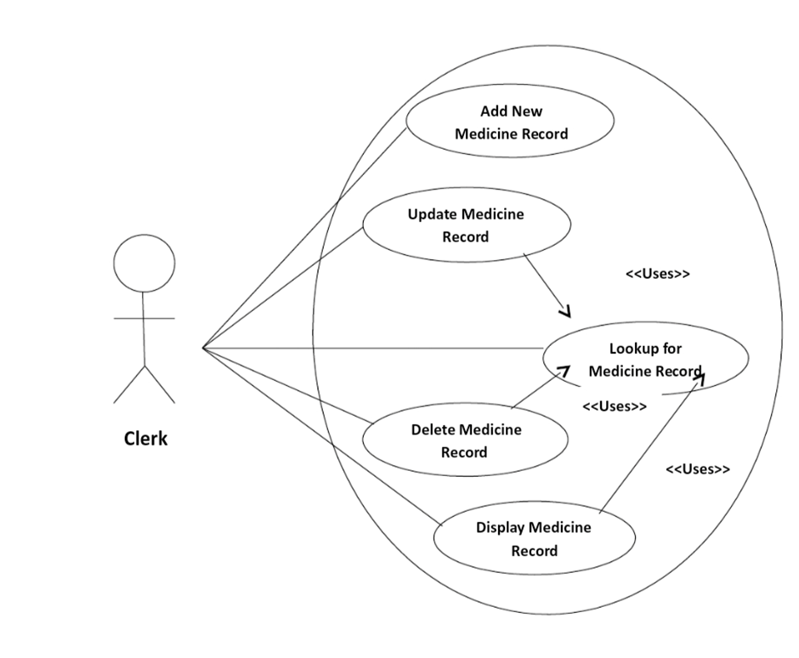
SYSTEM STRUCTURE
Fig. Use Case Diagram for Medicine Subsystem

Slide 14
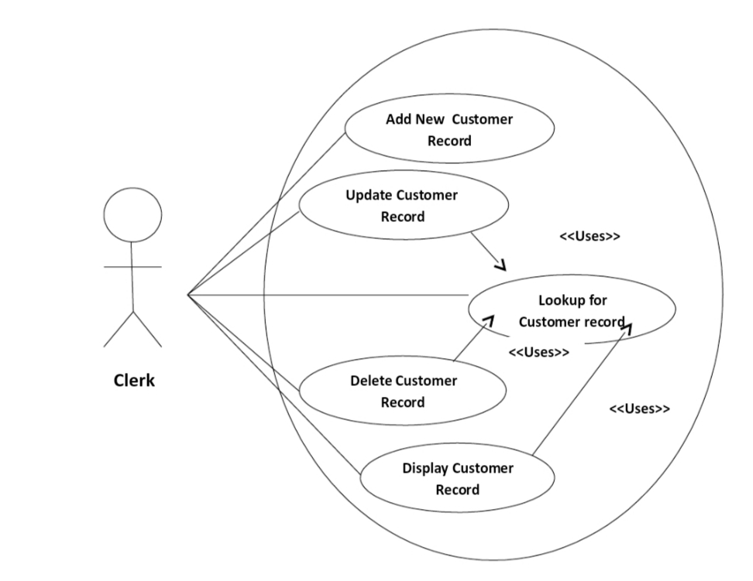

SYSTEM STRUCTURE
Fig. Use Case Diagram for Customer Subsystem

Slide 15
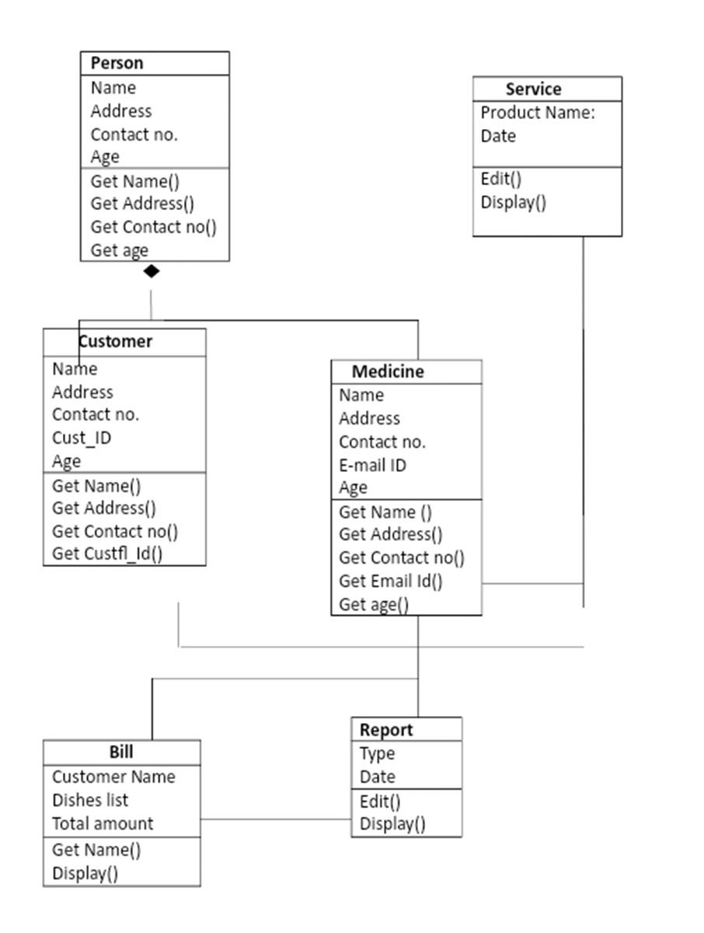
SYSTEM STRUCTURE
Fig. Class Diagram

Slide 16
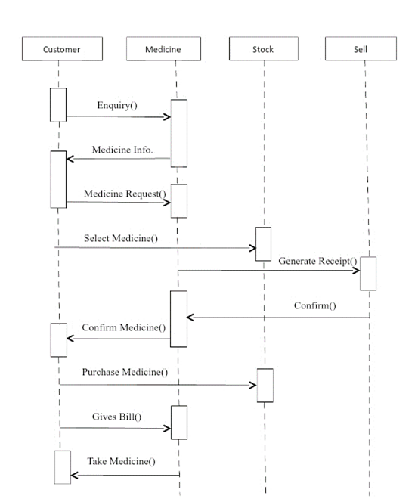
SYSTEM STRUCTURE
Fig. Sequence Diagram

Slide 17
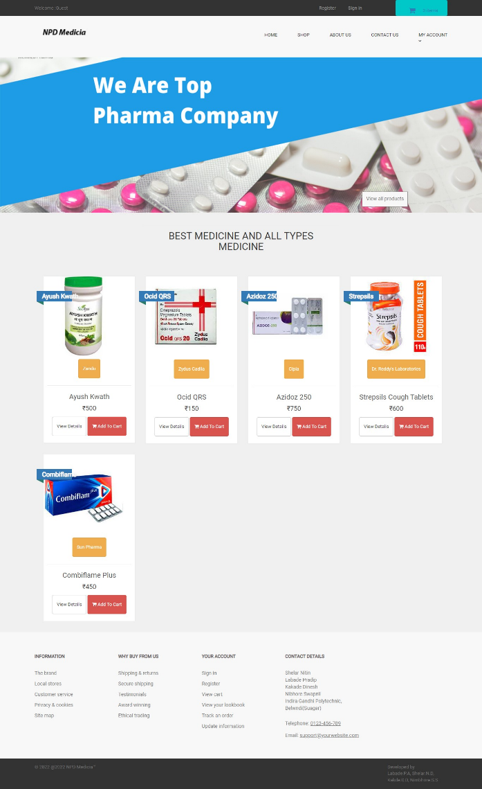
SCREENSHOT’S
Fig. Home Page

Slide 18
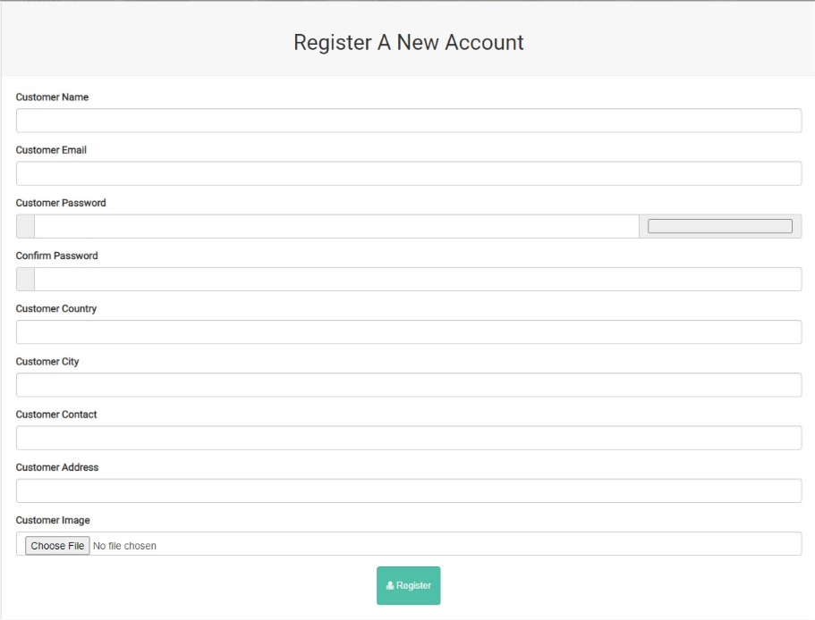
SCREENSHOT’S
Fig. Registration Page

Slide 19
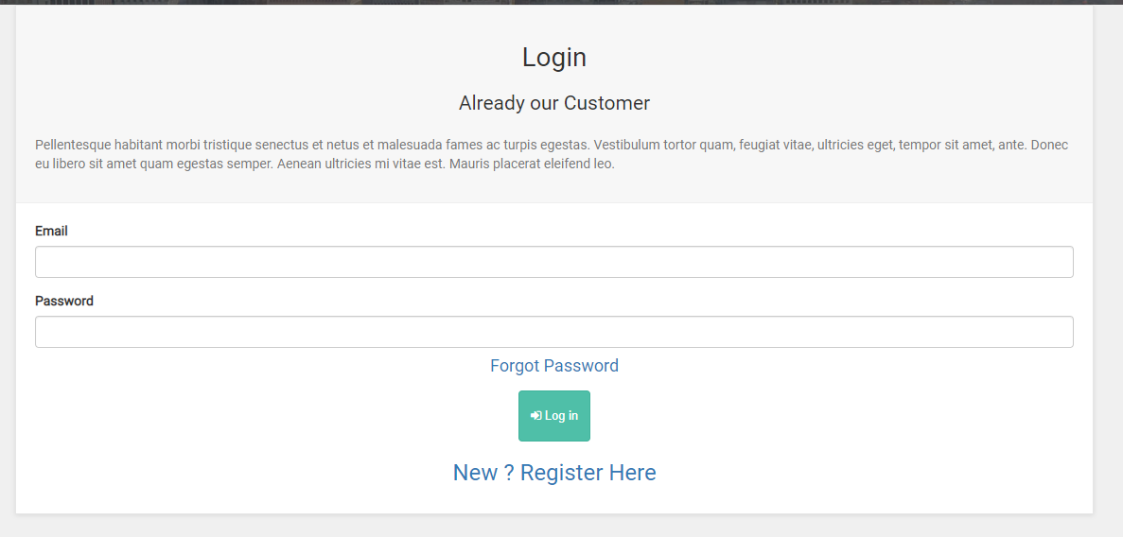
SCREENSHOT’S
Fig. Login Page

Slide 20
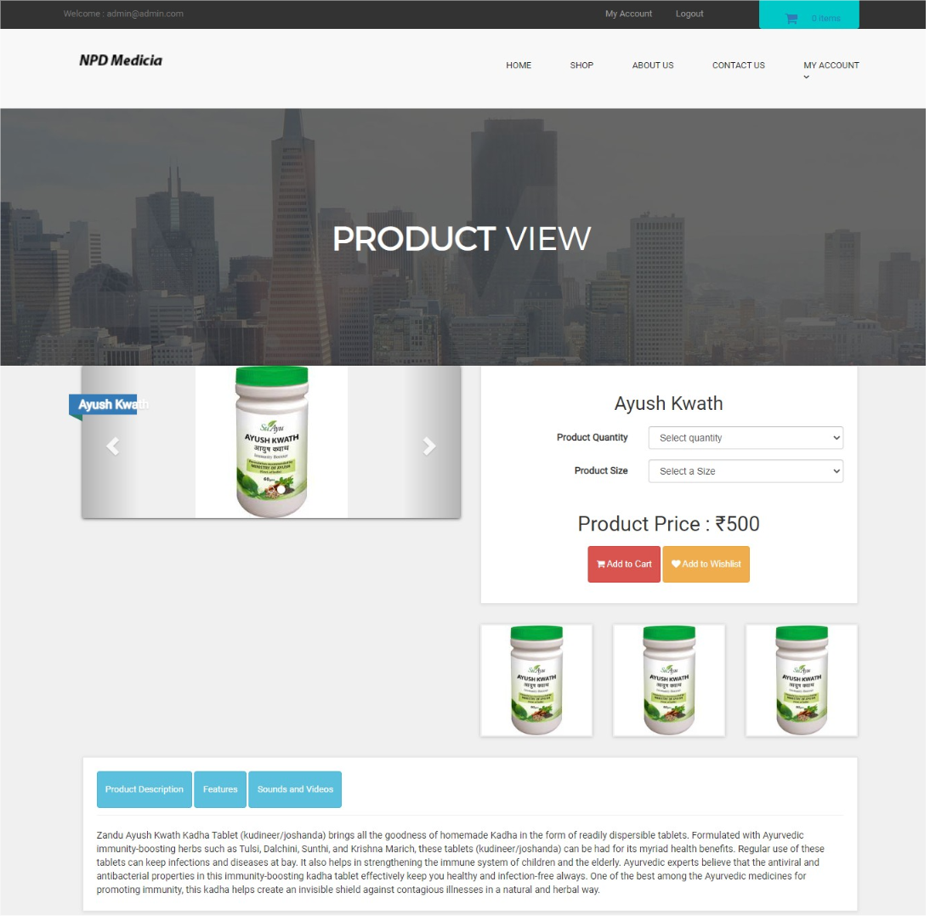
SCREENSHOT’S
Fig. Product View

Slide 21
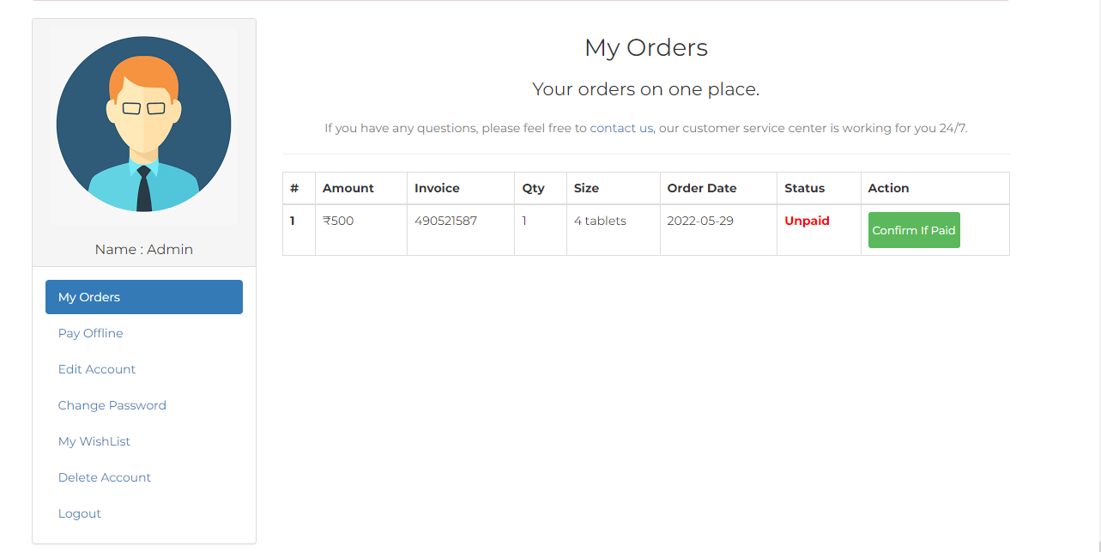
SCREENSHOT’S
Fig. Order Page

Slide 22
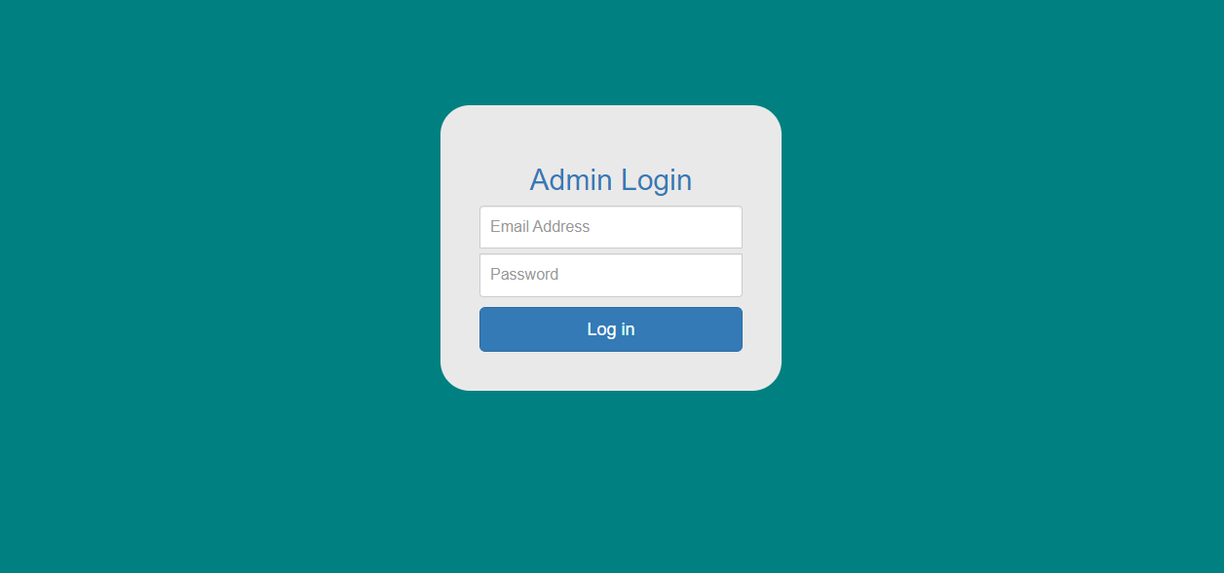
SCREENSHOT’S
Fig. Administration Login Page

Slide 23
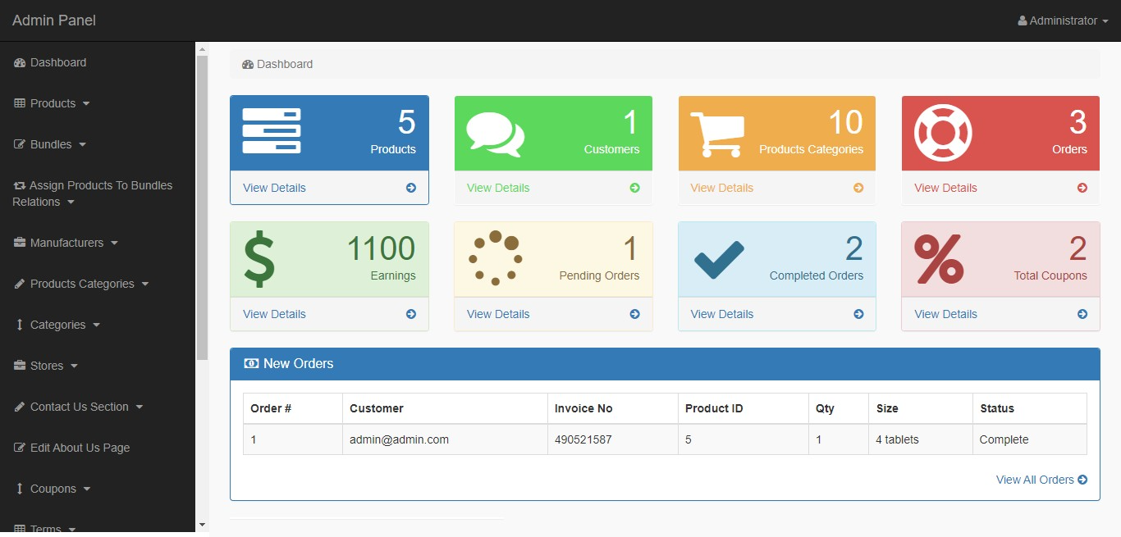
SCREENSHOT’S
Fig. Administration Home Page

Slide 24
CONCLUSION
The management system employs strict measures to protect the users from intruders or outsiders. One of such measures is the inability of a prospective user to register on the platform without the permission of the administrators. To register on the platform, all necessary details such as: name, address, tax documents, payment methods, and relevant licenses are sent to the administrator for proper verification. When the authenticity of these documents have been proven, the administrator then creates the account for the customer and forwards the details for login to the management system. Also, since the drugs purchased through the platform are for pharmaceutical purposes, and as such, are ordered in bulk, if a small quantity of drugs is ordered, the administrators are notified, who then confirms the order from the pharmacy to ensure that an intruder has not obtained their login details

Slide 25
FUTURE SCOPE
In a nutshell, it can be summarized that the future scope of the project circles around maintaining information regarding
We can add printer in future.
We can give more advance software for Medical Shop Management System including more facilities
We will host the platform on online servers to make it accessible worldwide
Integrate multiple load balancers to distribute the loads of the system
Create the master and slave database structure to reduce the overload of the database queries
Implement the backup mechanism for taking backup of codebase and database on regular basis on different servers.

Slide 26
REFERENCE
[1] Lidong Wang , Chery and Ann Alexander, “Medical Applications and Healthcare Based on
Cloud Computing” International Journal of Cloud Computing and Services Science (IJCLOSER) , ISSN: 2089-3337, Vol.2, No.4, August 2014, pp. 217-225.
[2] Lena Griebel,, Hans-Ulrich Prokosch, Felix Köpcke, Dennis Toddenroth, Jan Christoph,
Ines Leb, Igor Engel, and Martin Sedlmayr, “A scoping review of cloud computing in
healthcare”, BMC Med Inform Decis Mak, Vol 15, No. 17, . 2015.
[3] Sobeslav V, Maresova P, Krejcar O, Franca TC, Kuca K, “ Use of cloud computing in
biomedicine” J Biomol Struct Dyn. Vol. 34, No. 12, pp. 2688-2697, 2016.
[4] S. Nirmala Sugirtha Rajini and E. Mercy Beulah, “Cloud Based Architecture For Healthcare
System”, Asian Journal of Microbiology, Biotechnology & Environmental Sciences, Vol 18,
No. 4, pp. 1017-1018, 2016
[5] Luo S and Ren B. , “The monitoring and managing application of cloud computing based
on Internet of Things”, Comput Methods Programs Biomed.”, Vol.130, pp. 154-161, 2016.

Slide 27
Thank YOU
🙏

